Slide 1
Software Development Lifecycle
The process of constructing software
systems

Slide 2
Overview
Case-study
Elements of the lifecycle
Waterfall Model
Prototyping
Bohem’s Spiral Model
Process visibility

Slide 3
AutoSteve case study
Over the years, Aberystwyth Computer Science dept. has researched the issue of automating FMEA for electrical systems. Result was a system called FLAME.
Ford and Jaguar were project collaborators.
FLAME was research quality.
In 1994/5 we entered discussions to run a project to redevelop FLAME as a commercial quality application.
AutoSteve project started in September 1995.

Slide 4
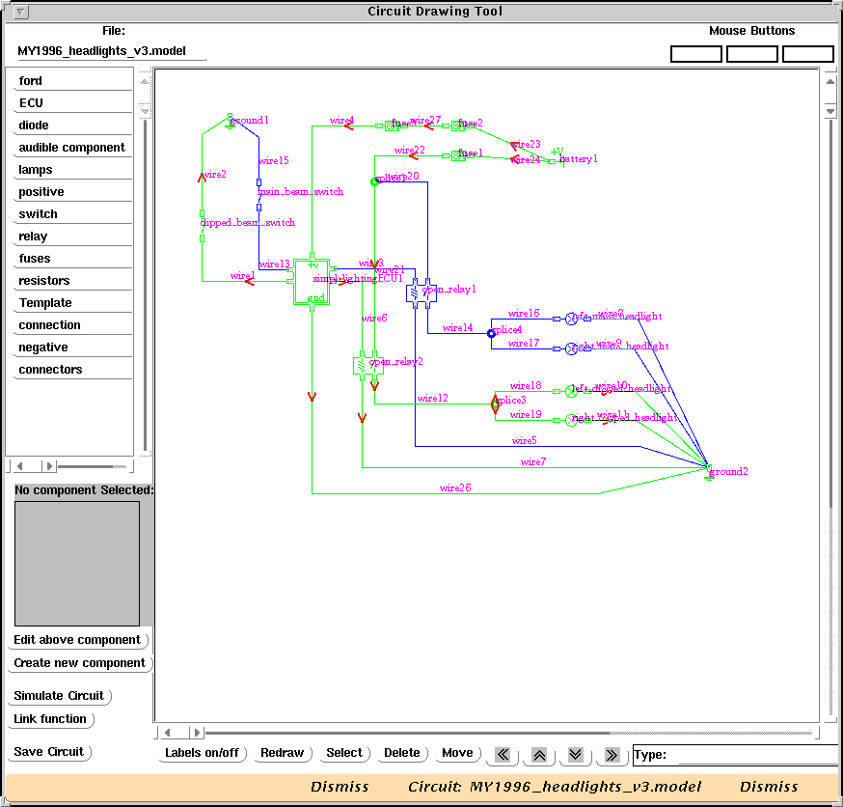

Slide 5
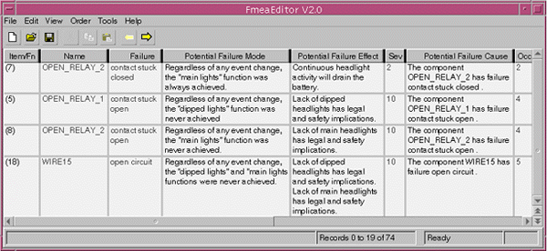
Resulting FMEA report

Slide 6
Project Outline
Duration : 18 months
Effort : 5 person years (60 months)
Aim : Re-implement electrical analysis software in C++
Customer : Ford Motor Co. Ltd.
Supplier : UW Aberystwyth
Project Manager : Dr. Chris Price.
Slow start as Ford were slow to raise funds.

Slide 7
Requirements
Two person months of Requirements Definition - even though we already had a working version. This work essentially concentrated on differences since FLAME.
Deliverable : Requirements Specification.
Described main functional requirements:
  QCAT simulator
  CAD style tool
  Display results and Produce FMEA report
  SCA/FTA etc.
Other requirements:
  Platforms (Solaris, NT, HP/UX)

Slide 8
Design
At the same time as writing the requirements, we identified difficult parts of new system and experimented with prototypes, including taking into account significant change to the way Ford worked.
Deliverables :
  Top level design
  Plan for detailed design and implementation
Also defined Quality Plan and Coding Standards during this time.

Slide 9
Changes to plan
By end of January 1996, parts of plan looked like this:
This document is based on document “Redoing FLAME in C++”, produced on 15th Sept. 1995. That document is now outdated for two main reasons:
1. Progress has been slow because of delays in funding. Much less effort has gone into design and productivity of the system than was expected at this point. On the positive side, this has made the second change much easier to contemplate.
2. The target system has been changed somewhat because of a desire to time FLAME more closely to Powerview and Ford’s other design tools. The effect of this change has been to alter the interface building parts of the project and to increase the uncertainty of quite how some items will be implemented, while simplifying that interface and possibly saving time and effort compared with building the interface from scratch.

Slide 10
Plan extracts continued...
Ford would like to keep to the original delivery date of September 1996, despite the delay in establishing the project properly. We believe that this is possible because of the help in interface building provided by Powerview, and that there is no longer a requirement to produce interfaces on PC platforms in this time frame.
Our strategy for keeping to this delivery time frame has been to identify all the code needed to produce useful FMEAs, and implement that code first, followed by less vital code (such as rearranging FMEA reports in interesting ways). This will extend the project beyond the end of 1996, but should not extend the budget needed beyond that in the original plan.

Slide 11
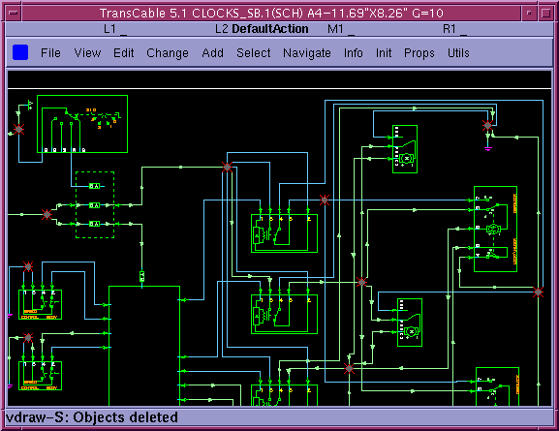

Slide 12
Proposed timetable
Item Delivered at end of month
QCAT circuit simulator Feb. 96
Interface to obtain circuits from Powerview Feb. 96
Effects generation code May 96
Component builder May 96
Generation of report text June 96
RPN generation code June 96
Paper-based FMEA report form June 96
Screen-based FMEA report form Sep. 96
Further interfacing to Powerview Sep. 96
Interactive circuit simulation Sep. 96
Sneak circuit analysis Nov. 96
Fault Tree generation Nov. 96
Extra report ordering (incremental etc.) Dec. 96
Export of FMEA details to other Ford tools Dec. 96

Slide 13
Project Progress
Weekly internal meetings looking at how the work was progressing.
Monthly meetings with Ford to report on progress against plan.
March and June made deliveries of intermediate versions of software for Ford to try out (some bugs found).
Regression testing instigated in March.

Slide 14
September 1996
At the start of this month:
  5 people working on the project.
  One of the May deliverables has not happened yet.
    Problems made worse by change of staff on that part of the project. This has not held up rest of project considerably, because our design has allowed for this.
    Cannot build new components, but can import from non-C++ system.
Alpha test version delivered in late October.
Beta test version delivered in December.
Project version delivered in March (as planned).

Slide 15
Now ...
AutoSteve is now in use at Ford and Jaguar at several sites around the world.
We are currently maintaining the software
  Fixing bugs.
    Need to control changes.
  Improving functionality.
  Helping engineer’s with items they don’t understand.

Slide 16
Diverse systems
Operating System
  Networked, Stand-alone, Distributed, Embedded.
Office productivity
  Word Processors, Spreadsheets, Email, Databases.
Control Systems
  ABS (Anti-lock Braking System),Nuclear Power Station, Air Traffic Control
Design and Analysis
  CAD systems, 3D Modelling, Animation
Consumer
  Video, CD players, Microwaves

Slide 17
Developing Software
What are the different stages of software development?

Slide 18
Requirements Analysis
Requirements establish the services which a system must provide and the constraints under which it must operate.
Somerville points out that there are two sorts of requirements, because there are often different pressures:
  End user requirements. The user wants the best possible system.
  System builder pressures. The developers want to get the job done.
These pressures can be in direct opposition.

Slide 19
Design
Software [or hardware] design identifies how each system function will be accomplished.
Composed of architectural and detailed design:
Architectural Design - overall specification of architecture, control structure, data structure and test plans.
Detailed Design - breakdown into modules & test plans.
functional/object oriented

Slide 20
Implementation & Testing
Implementation - involves realising the design through writing code, and integrating any necessary hardware.
Unit testing - verify that each unit meets its specification.
Integration & system testing - individual program units or programs are integrated and tested as a complete system to ensure requirements are met.
Acceptance testing - getting the user to accept the system, including installation and training courses.

Slide 21
Maintenance
Very often the longest and most costly phase of project.
Costs can be reduced during design and implementation by making the system easier to maintain.
E.g AutoSteve - delivered in March ‘97, still maintaining software today.

Slide 22
The Software Process
Various definitions of process used to develop systems:
  Waterfall Model. First explicit model of software development.
  Evolution Prototyping.
  Incremental Development.
  Boehm’s Spiral Model. Influential model over the past ten years.

Slide 23
Waterfall Model
Requirements
Definition
System &
Software Design
Implementation
& unit testing
Integration &
System Testing
Operation &
Maintenance
Notes:
Each phase is defined in terms of output during the phase, not by the activities occurring within the phase.
A tangible output is the only criterion of progress - helps eliminate the 90% complete syndrome.
A phase product represents a natural milestone, a change of emphasis point, and is used as the basis for the next phase.
Products of next phase can be formally verified against the previous as part of quality assessment.

Slide 24
Waterfall Model
Each phase is defined in terms of output during the phase, not only by the activities occurring.
A tangible output is the only criterion of progress.
A phase product represents a natural milestone, a change in emphasis point, and is used as the basis for the next phase.
Products of next phase can be formally verified against the previous as part of quality assessment.

Slide 25
Pros. And Cons.
Pros:
  Clear, simple to understand development process.
  Makes development process visible.
  Makes planning/management/system building easier.
  Less likely to affect overall design by late design changes.
Cons:
  Inflexible.
  Makes responding to changes harder.
  Less likely to build what the user wants.
  In practice, stages overlap with each other.

Slide 26
The model in real life
Exploratory work on a subsequent phase, including costing, is usually required before a phase can be completed.
Problems encountered in a later phase may involve reworking earlier phases.
User’s perceived requirements may change during the software development process.
Incremental development may be used, with different increments of a product used in different product phases.
Prototypes may be developed.

Slide 27
Evolutionary Prototyping
Develop
specification
Build
prototype
Try out
the system
no
Does
system do what
User wants
Deliver the
system
yes

Slide 28
Evolutionary Prototyping
Applied when it is difficult to describe exact requirements or when it is not clear what a solution to hard design problems will look like.
More like an excuse for not having a methodology.
Prototyping is often necessary, but is not a methodology.
Because of the need for reliability, prototypes should be thrown away, although the ideas and experience gained through building them should be fed into the system development.

Slide 29
Incremental Development
Requirements
Definition
System and
Software Design
Specify change
to system
Build System
Increment
Test
Increment
Deliver final
system
System
Complete?
Test whole
system
Integrate
Increment

Slide 30
Incremental Development
Good chance you will find this in practice, especially on smaller projects where there aren’t enough staff to build everything at once.
Really only a variation on waterfall model.
Might do appropriate prototyping:
  either to establish requirements;
  or to explore hard parts of the design.
Change strategy for implementation and testing. Have an overall structure and bring pieces together as they are ready.

Slide 31
Incremental development
Advantages:
  Extra milestones.
  Avoids some crises, by alerting to problems earlier.
  Often gets user feedback earlier.
Disadvantages:
  Doesn’t work for all systems - might not be able to do integrated testing until all bits implemented.
  Need a good design and understanding of the dependencies between modules for it to work well.

Slide 32
Boehm’s Spiral Model
This has been an influential model over the past ten years.
It recognises that there is iteration between the different steps of the waterfall, and that the iteration needs to be explored before a complete design can be made.
In order to do this, you split your project into iterative loops and assess risk.

Slide 33
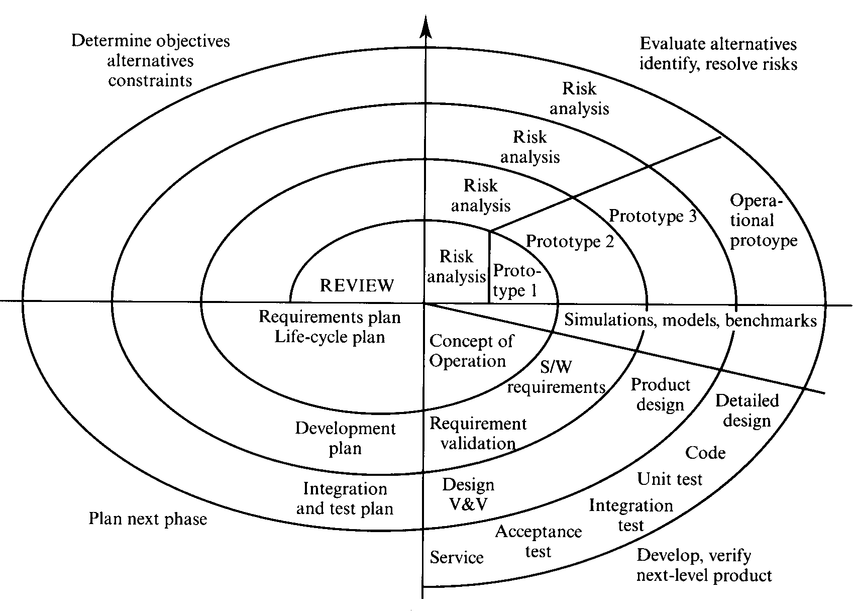
Spiral Model

Slide 34
Loop Activities
On each loop, you do four things:
  Set specific objectives.
    Decide what the purpose of this loop is, and what the outcomes should be (e.g. produce req. spec.)
  Evaluate alternatives, identify and resolve risks.
    Often include building prototypes.
  Develop/validate.
  Plan next phase.
    View project and decide if/how to continue. Draw up plans.

Slide 35
Points on Spiral Model
Risk analysis and evaluations is made explicit at each level.
Constructing prototypes is identified as a part of the lifecycle.
Allows different lifecycle models to be used within each loop of the spiral (really a meta-model)

Slide 36
Risk management
Boehm suggests a standard form is filled in on each iteration:
  Objectives
  Constraints
  Alternatives
  Risks
  Risk Resolution
  Results
  Plans
  Commitment
More detail in section 1.3.1 of Sommerville.

Slide 37
Process visibility
Software managers need feedback on progress
Each activity must end with some document/code.
Drawbacks:
  Timing of documents may not correspond to time needed to complete an activity.
  Costs of adapting completed deliverables are high. As such, a “fix” may be adopted to avoid this.
  Due to time to review a document, development may continue onto next stage before a document is formally accepted.

Slide 38
Example deliverables in Waterfall Model
Requirements analysis
  Feasibility Study.
  Outline Requirements
Requirements Definition
  Requirements Document
System Specification
  Functional Specification
  Acceptance Test plan
  Draft User Manual

Slide 39
Documents continued...
Architectural design
  Architectural specification
  System test plan
Interface design
  Interface specification
  Integration test plan
Detailed Design
  Design specification
  Unit Test Plan
Coding
  Program code

Slide 40
Documents continued...
Unit testing
  Unit test report
Module testing
  Module test report
Integration testing
  Integration test report
  Final user manual
System Testing
  System test report.
Acceptance Testing
  Final system & documentation

Slide 41
Visibility in the process models
Most models produce documents at certain points in the process. Therefore, they are quite visible.
Problems with prototyping models, where it is uneconomic to produce reports on each iteration.
  leads to management and quality problems.
See table on page 18 of Sommerville.

Slide 42
Summary
Nothing magical about software process models
Each raises some valid issues about what is involved in developing software
Doesn’t help when scheduling tasks with main elements - down to management
Even if followed, they don’t guarantee successful project development.
  Mix of staff skills
  Quality procedures
  Clear management

Slide 43
Giving reasons for your answer based on the type of system being developed, suggest the most appropriate generic software process model which might be used as a basis for managing and development of the following systems:
A system used to control anti-lock braking in a car.
A virtual reality system to support software maintenance.
A university accounting system which is intended to replace an existing system.
An interactive system which allows railway passengers to find train times from terminals installed in stations.

Slide 44
A university intends to procure an integrated student management system holding details of registered students including personal information, courses taken and examination marks achieved. The alternative approaches to be adopted are either:
Buy a database management system and develop an in-house system based on this database.
Buy a system from another university and modify it to local requirements.
Join a consortium of other universities, establish common set of requirements and contract a software house to develop a single system for all of the universities in the consortium.
Identify possible risks for each and suggest risk resolution strategies.

